Slide 1
Logging in JBOSS EAP

Slide 2
Log levels
The most commonly used six log levels are (in order of lowest criticality to highest):
TRACE
DEBUG
INFO
WARN
ERROR
FATAL

Slide 3
Log Levels explained
TRACE Used for messages that provide detailed information about the running state of an application.
DEBUG Used for messages that indicate the progress individual requests or activities of an application.
INFO Used for messages that indicate the overall progress of the application. Often used for application startup, shutdown and other major lifecycle events.
WARN Used to indicate a situation that is not in error but is not considered ideal. May indicate circumstances that may lead to errors in the future.
ERROR Used to indicate an error that has occurred that could prevent the current activity or request from completing but will not prevent the application from running.
FATAL Used to indicate events that could cause critical service failure and application shutdown and possibly cause JBoss Enterprise Application Platform to shutdown.

Slide 4
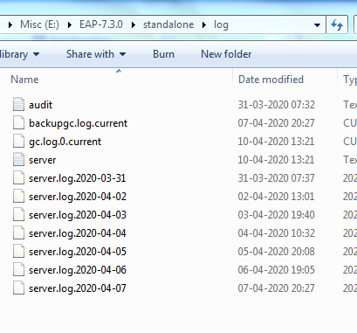
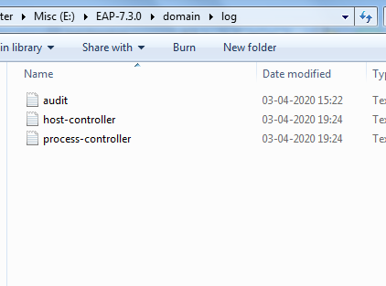
Log folder path
Log files are present in E:\EAP-7.3.0\standalone\log and E:\EAP-7.3.0\domain\log

Slide 5
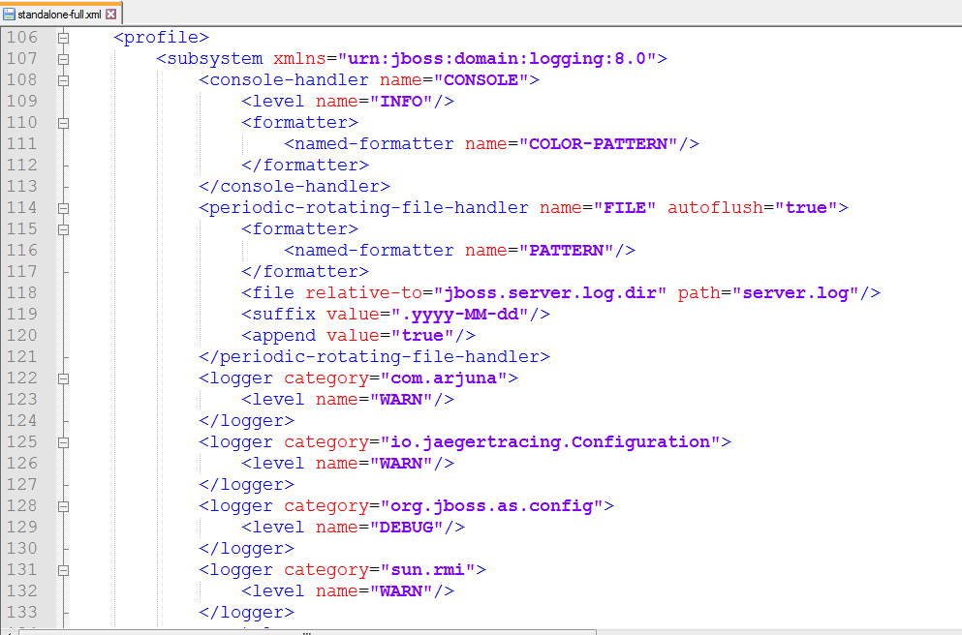
Logging Subsystem
Root logger,
Log handler,
Log formatter

Slide 6
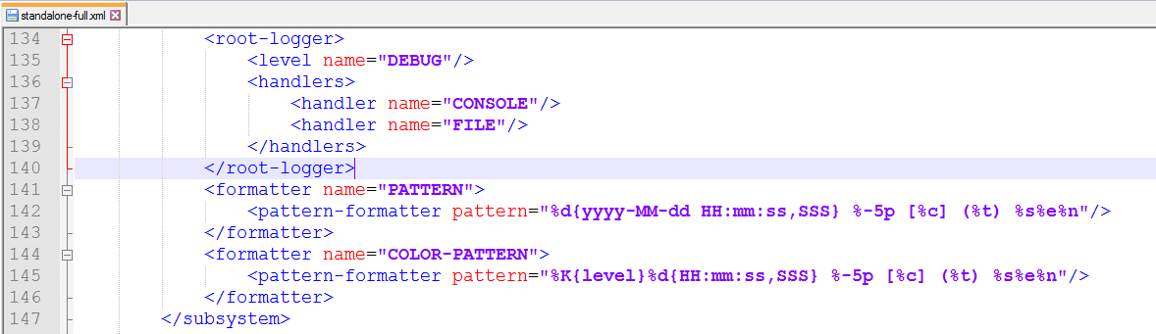
Logging Subsystem

Slide 7
Root Logger
The root logger captures all log messages sent to the server (of a specified level) that are not captured by a log category.
These messages are then sent to one or more log handlers.
By default the root logger is configured to use a console and a periodic log handler.

Slide 8
Types of Log Handlers
Console
Console log handlers write log messages to either the host operating system’s standard out (stdout) or standard error (stderr) stream.
The messages from a Console log handler are not saved unless the operating system is configured to captured the standard out or standard error stream.
File
File log handlers are the simplest log handlers that write log messages to a specified file.
Periodic
Periodic file handlers write log messages to a named file until a specified period of time has elapsed. Once the time period has past then the file is renamed by appending the specified timestamp and the handler continues to write into a newly created log file with the original name.

Slide 9
Types of Log Handlers
Size
Size log handlers write log messages to a named file until the file reaches a specified size. When the file reaches a specified size, it is renamed with a numeric prefix and the handler continues to write into a newly created log file with the original name.
Each size log handler must specify the maximum number of files to be kept in this fashion
Async
Async log handlers are wrapper log handlers that provide asynchronous behaviour for one or more other log handlers.
These are useful for log handlers that may have high latency or other performance problems such as writing a log file to a network file system.
Custom
Custom log handlers enable to you to configure new types of log handlers that have been implemented.

Slide 10
Log Formatters
A log formatter is the configuration property of a log handler that defines the appearance of log messages from that handler.
It is a string that uses a syntax based on java.util.Formatter class.
Login to the Management Console Navigate to the logging subsystem configuration.
This step varies between servers running as standalone servers and servers running in a managed domain.
Standalone Server Click on Profile, expand Core in the Profile pane, and then click on Logging.
Managed Domain Click on Profile, select the profile to edit, expand Core, and then click on Logging.

Slide 11
The tasks you can perform to configure the root logger are:
Edit the log level.
Add and remove log handlers.
The tasks you can perform to configure log categories are:
Add and remove log categories.
Edit log category properties.
Add and remove log handlers from a category.

Slide 12
References
https://github.com/wildfly/wildfly/blob/master/docs/src/main/asciidoc/_admin-guide/subsystem-configuration/Logging_Formatters.adoc
https://github.com/wildfly/wildfly/blob/master/docs/src/main/asciidoc/_admin-guide/subsystem-configuration/Logging_Handlers.adoc

